Slide 1



Slide 2
The Science Behind IP
Infinite Possibilities: Train the Trainer Conference
Ventura, 2015

Slide 3







Introduction
Who is David Casti?
Notes:
Who is David Casti?
Certified IP Trainer and management consultant.
Customers include many household names:
Time Warner, Comcast, British Telecom
US Departments of State, Energy, and Treasury

Slide 4


Some Basics…
Questions?
Send them to
david@casti.com
Notes:
We will not be breaking any new scientific ground tonight. Everything discussed is uncontroversial, settled science.
Contact me to get a “handout copy” of today’s presentation
Please send me your questions at david@casti.com

Slide 5

Are You Saying IP Is Not Spiritual?
Notes:
No.
As Infinite Possibilities (“IP”) trainers, we are looking for ways to help people improve their lives, regardless of their background.
Many audiences will be comfortable with discussions involving magic, miracles, God, and other “spiritual” concepts.

Slide 6


A Bonus to the “Non-Spiritual” Approach
Notes:
IP can be viewed purely practically, as technology that can be used to help you achieve your goals.
By reorienting the discussion away from metaphysical models of existence and towards practical scientific principals, the course becomes about how to make your life the best it can be – whatever that means to you.
Nazis, AIDS, evil and atrocities of every kind are now out-of-scope for our class.
The focus of class becomes about making your life the best it can be, not explaining the history of the world or human suffering.

Slide 7


Additional Resources
Notes:
Because we have a lot of material, I am going to do more “telling” than “explaining”, and we’ve taken all the exercises out of the presentation.
Everything I talk about is covered in detail in the bibliography at the back of this presentation.

Slide 8
THE HUMAN BRAIN
The Missing Manual

Slide 9

The Most Basic Principle
“ASSOCIATION”
Notes:
Association is any connection between any two ideas or experiences.

Slide 10

The Most Basic Principle
Association Example
“A Lion Makes Me Think Of…”

Slide 11


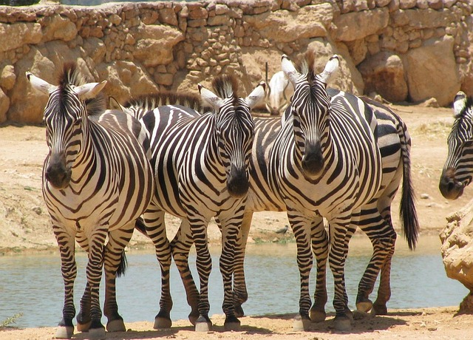

The Most Basic Principle
The Trigger

Slide 12

But That’s Just the Beginning…
Notes:
Triggers in the form of sensory stimulation are raining down on you continuously.
Our nervous system captures a staggering amount of data and almost all of it is screened out before it reaches our consciousness.
BUT!...

Slide 13

But That’s Just the Beginning…
Notes:
In addition to deleting data, our nervous system has a silent editing capability that would put any Hollywood special effects studio to shame.

Slide 14
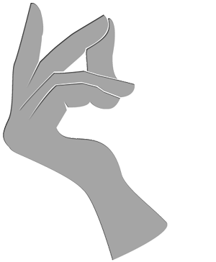

Editing Example: The Finger Snap
Notes:
Prepare to snap your fingers.
Look at your thumb, feel it against your finger.
Now keep watching as you snap and hear the noise.
Notice that you experienced all three senses simultaneously:
The feel of your thumb against your fingers
The sound of the snap
The sight of your fingers sliding over each other
These events were synchronized in time from your point of view!

Slide 15
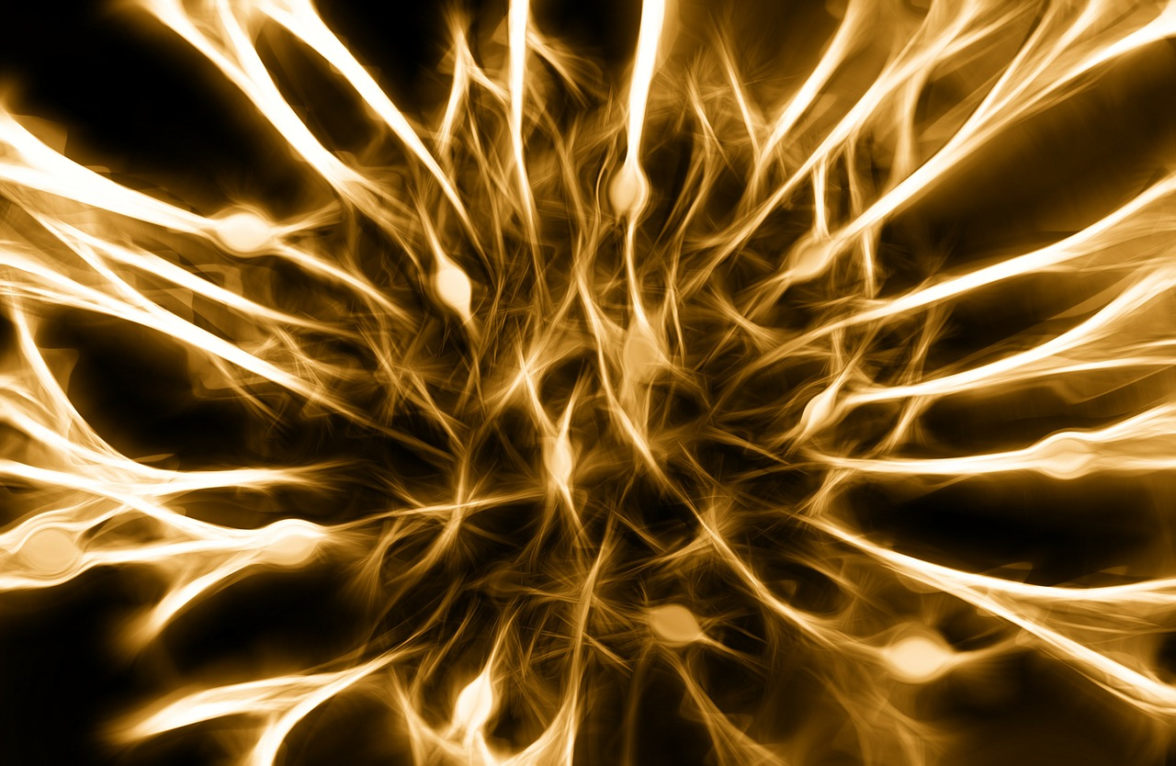

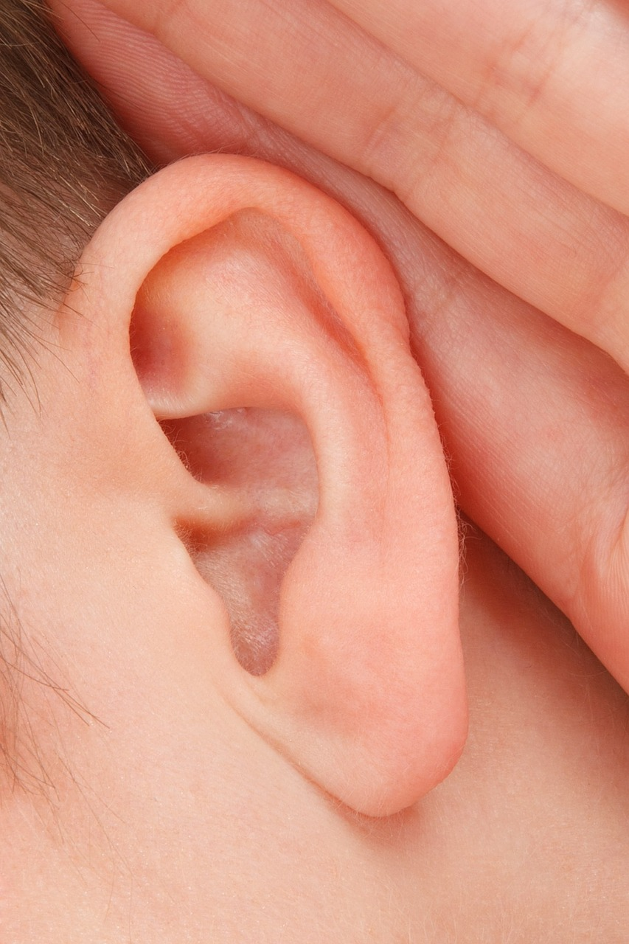



Sensory Editing Example: Finger Snap
Notes:
Notice that you experienced all three senses simultaneously:
The feel of your thumb against your fingers
The sound of the snap
The sight of your fingers sliding over each other
The real story is that information from each of those senses arrived to your brain at very different times:
The nerve impulse traveled along your arm and into your brain at 200 mph,
The sound traveled to each of yours ears at 700 mph, and
The light traveled to your retina at 670 million mph!
As a result, data from your senses about your finger snap was reported to your brain more than 1/20th of a second apart.

Slide 16

Sensory Editing Powers
Your brain typically exercises editing over events up to 1/10th of a second apart!
Notes:
Your brain edited everything back together so it appears to you that all three things happened at the same time.
1/20th of a second doesn’t sound like much, but …
if you were watching a movie with a black frame every 20th of a second it would blink
if the sound of my voice was 1/20th of a second behind my lips moving it would be so disturbing you would look away.
Your brain typically exercises editing over events up to 1/10th of a second apart.

Slide 17

The Most Important Thing To Notice
You Have No Awareness of The Edits!
Notes:
The Most Important Point About Your Brain’s Awesome Editing Powers is that You have no awareness that any editing happened!
Your consciousness simply received a finished picture of reality, completely “cleaned up” and ready to act upon!
There is no sensation to signal anything has been edited at all.

Slide 18
Introducing Your Two
Thinking Systems

Slide 19
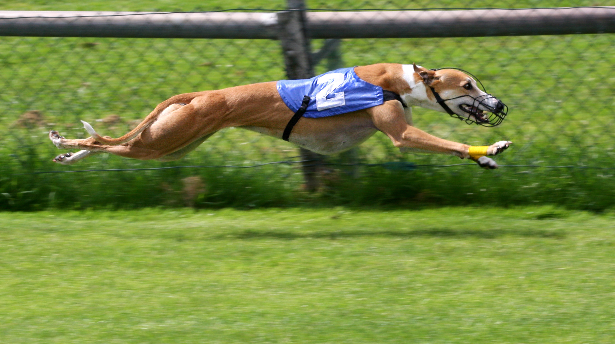

Introducing Two Thinking Systems
Fast
Search & Fetch
Ancient
Automatic
Slow
Analyze & Plan
New Invention
Intentional
Notes:
Nobel prize winning psychologist Daniel Kahneman suggests one way to talk about this process. He says we have two different thinking systems: one “fast” and one “slow”.
These thinking systems have very different features and functions, both completely critical.

Slide 20

Fast Thinking Creates Your Worldview
Notes:
“Fast Thinking” is the part of our brain that processes incoming information, and associates it to everything we already know. It creates our view of the world and takes many short-cuts, because it doesn’t have a lot of time.

Slide 21

Slow Thinking is Your Executive
Notes:
“Slow Thinking” is our “executive function” – the part that analyzes and makes tough decisions, sets goals and priorities. It is the part we normally think of as “us”, and everything it does is influenced by our Fast Thinking.

Slide 22
Fast Thinking Close Up
I’m going to read a sentence and you
will see a picture appear in your
mind as if by magic!
Notes:
Let’s now look closely at one aspect of Fast Thinking using an exercise. I am going to read a sentence out loud and you will see a picture matching that sentence appear in your mind.
“Anne approached the bank.” Did you see…
Note that whichever image you saw, you did not see the other one at the same time!

Slide 23


Fast Thinking Close Up
“Anne approached the bank.”
Notes:
Let’s now look closely at one aspect of Fast Thinking using an exercise. I am going to read a sentence out loud and you will see a picture matching that sentence appear in your mind.
“Anne approached the bank.” Did you see…
Note that whichever image you saw, you did not see the other one at the same time!

Slide 24

A Few Things to Notice…
Notes:
You did not have the sense that you were seeing “only one” of many possible images. The image which first appeared stood alone.
You did not doubt or question your interpretation. The images which appear are fully trusted.
You did not get mixed up into images competing with each other, like a woman holding a handbag in a boat going towards a building. The images which appear are always internally consistent. Fast Thinking always produces consistent world views.

Slide 25

Fast Thinking: Not Just for Words!
Notes:
Consider the following image…

Slide 26

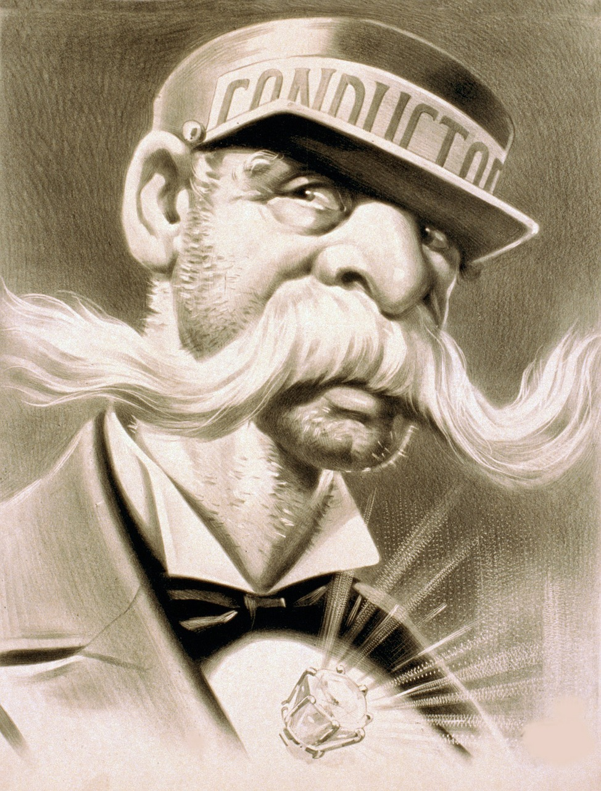

Fast Thinking: Not Just for Words!
Notes:
One way to understand why Fast Thinking can not hold a contradiction is to imagine that information gets “used up” as your world view is constructed.
Once information has been assigned one meaning, it can not take on a contradictory meaning.
You can flip back and forth.
You can intellectually know all images are valid interpretations.
You can not fully see all images at the same time.

Slide 27
A Key Difference Between Fast & Slow
The BLUE button is TRUE
The RED button is FALSE
No Contradictions Allowed!
Notes:
Fast thinking is not able to think a contradiction. This is very important and it is one key reason that IP works.
Fast thinking uses your biological association engine to construct a coherent picture of the world, and it can only construct one picture at a time.

Slide 28
Fast Thinking is Always On
Programming Your Fast Thinking Through Choices Instead of by Accident

Slide 29

The First Awesome Brain Power:
Always On
Notes:
Fast thinking is always on. It never stops. You can not turn it off.
Not only is it processing the words you hear people say, but it is processing everything you think, see, hear, do, feel, imagine, dream – everything in your consciousness has been “handled” by Fast Thinking – and comes to your awareness complete with a huge tree of associations.
You do not have conscious control over your Fast Thinking. Even when you know it is giving you incorrect information, you can not stop seeing the illusion. Fast Thinking shapes your entire experience of reality. It really is that powerful.

Slide 30

The First Awesome Brain Power:
Processes Everything
Notes:
Fast thinking is always on. It never stops. You can not turn it off.
Not only is it processing the words you hear people say, but it is processing everything you think, see, hear, do, feel, imagine, dream – everything in your consciousness has been “handled” by Fast Thinking – and comes to your awareness complete with a huge tree of associations.
You do not have conscious control over your Fast Thinking. Even when you know it is giving you incorrect information, you can not stop seeing the illusion. Fast Thinking shapes your entire experience of reality. It really is that powerful.

Slide 31

The First Awesome Brain Power:
Shapes Your Entire Experience of Reality
Notes:
Fast thinking is always on. It never stops. You can not turn it off.
Not only is it processing the words you hear people say, but it is processing everything you think, see, hear, do, feel, imagine, dream – everything in your consciousness has been “handled” by Fast Thinking – and comes to your awareness complete with a huge tree of associations.
You do not have conscious control over your Fast Thinking. Even when you know it is giving you incorrect information, you can not stop seeing the illusion. Fast Thinking shapes your entire experience of reality. It really is that powerful.

Slide 32
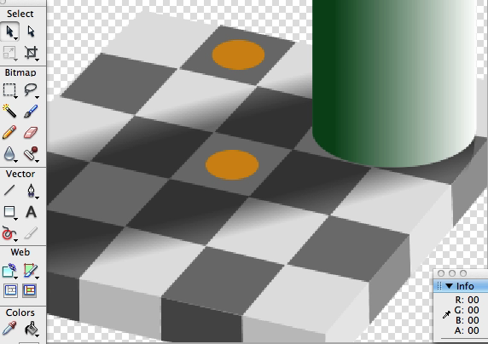
Fast Thinking is Not Always Correct

Slide 33

Cognitive Illusions
Notes:
Just as there are illusions in your senses, you live in a world filled with invisible cognitive illusions. Sometimes these are called “limiting beliefs”. Discovering your limiting beliefs does nothing to change them. Just as with the checkerboard, you can not consciously control Fast Thinking – and knowing it has made a mistake does not change your honest experience of the world.

Slide 34
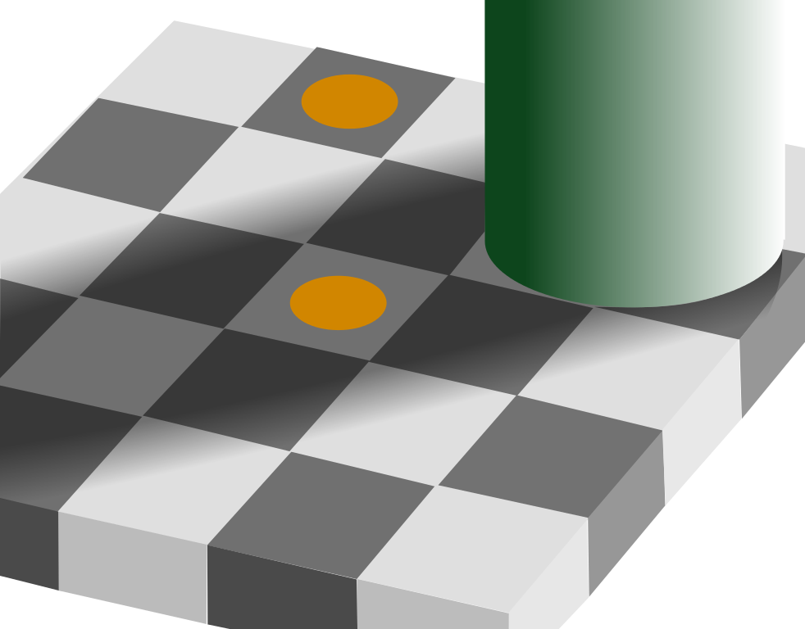
This is Why Willpower
Will Always Fail You:
Notes:
How many of you have ever felt like your willpower “let you down”? Like, if you had just “tried harder” you could have done it? I’m here to tell you, those thought that say you didn’t work hard enough or try hard enough or want it bad enough: those thoughts are all wrong. Look at this picture again, closely this time. You can not “will” yourself to see the colors are the same in this picture. You have ancient, automatic, biologically-wired systems that decide what is and is not “real” long before you ever get a chance to “decide” or use your “willpower”. As a result, the world that appears to you is silently and relentlessly shaped by your Fast Thinking. Therefore, taking control of your life requires getting ahead of these automatic processes and learning to reprogram them – so your world ACTUALLY APPEARS DIFFERENTLY TO YOU than it did before. Then willpower won’t even be needed.

Slide 35

Fast Thinking is NOT a Judge
Notes:
Fast thinking is not an executive decision-maker, so it doesn’t judge associations.

Slide 36


Associations Can Be…
Constructive
Or Destructive
Notes:
Therefore, its associations can be constructive or destructive to your goals.
Your role as the owner of a Fast Thinker is to re-program these associations so constructive ones emerge. This is the main activity of IP.

Slide 37

Reprogramming Your Fast Thinking is Super Easy!
Notes:
This is both good news and bad news. It means most of us have accidentally programmed ourselves with all manner of unhelpful associations!

Slide 38

New Associations Begin With
Notes:
Reprogramming begins with “anchoring”. Anchoring is establishing a new starting point for the associations which come next.

Slide 39
Setting an Anchor
SO_P
WASH SO_P
EAT SO_P

Slide 40
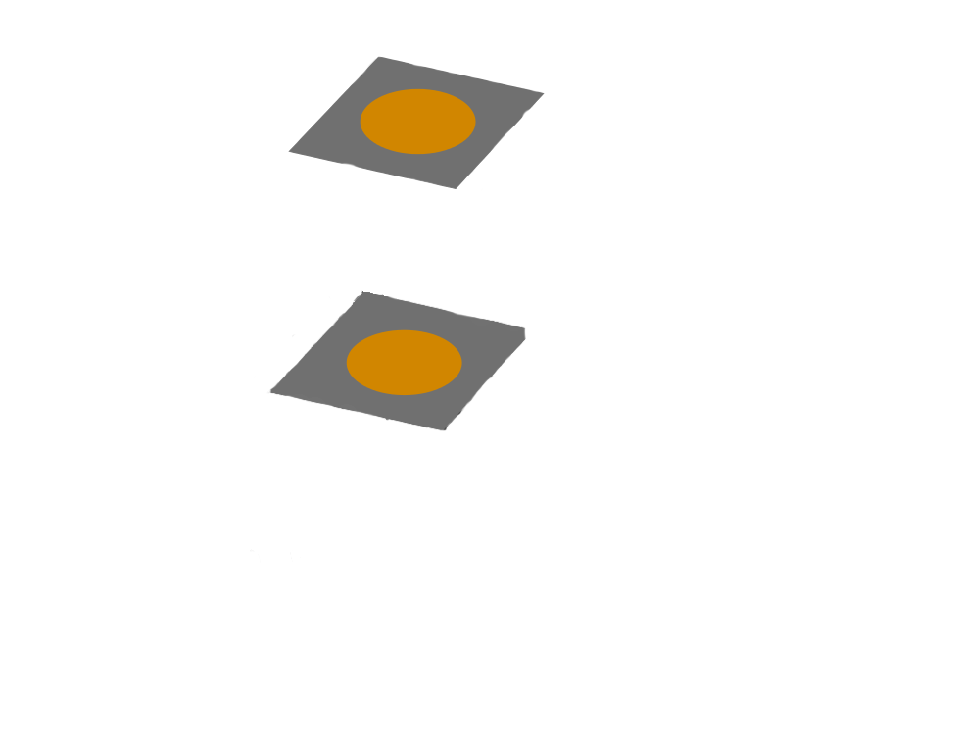
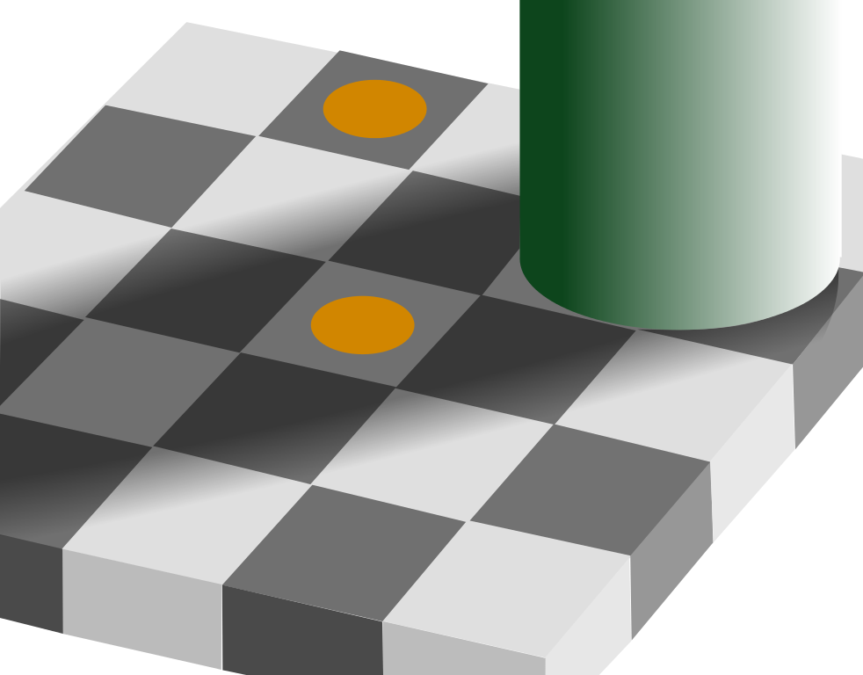
The Power of Anchoring
The Only Difference Is the Anchor

Slide 41






What Makes a Strong Association?
Notes:
Given incoming information, Fast Thinking searches your neural library for the strongest associations, and generates its picture of the world from them. Associations are stronger when they are:
More recent
This is why anchoring works!
More frequently used / repeated
Engaging more of your senses

Slide 42


What Makes a Strong Association?
Notes:
Created during a moment of high intensity
More unusual / novel / rare

Slide 43

If Visualizations and Affirmations Aren’t Magic, Why do They Work?
Notes:
Visualizations and affirmations work by reprogramming Fast Thinking to offer up new associations.
Your best visualizations perfectly match Fast Thinking’s strongest associating rules. They:
Are recent
Are frequently repeated – but not so often as to be ignored
Engage most/all of your senses
Stir up strong emotional intensity
Use imagery and ideas that are unusual / novel / rare
Coincidence?
No! Science.

Slide 44
Your Always-On Search Engine
How Fast Thinking Prepares Us For Our Lives

Slide 45
Fast Thinking is the Source of Inspiration
What Should I Do Next?
Notes:
Every self-conscious being is continuously confronted with the question: “What should I do next?”
Fast Thinking serves up answers to this question every time it is asked, based on the associations it has been programmed with.
If you program Fast Thinking with things you don’t want, it will inspire you to take actions that create the things you don’t want.
If you program Fast Thinking with things you do want, it will inspire you to take actions that create the things you do want. This may look like “magic”, but it is simply preparation meeting opportunity. … and speaking of preparation …

Slide 46

Fast Thinking Has Always Answered
Notes:
Every self-conscious being is continuously confronted with the question: “What should I do next?”
Fast Thinking serves up answers to this question every time it is asked, based on the associations it has been programmed with.
If you program Fast Thinking with things you don’t want, it will inspire you to take actions that create the things you don’t want.
If you program Fast Thinking with things you do want, it will inspire you to take actions that create the things you do want. This may look like “magic”, but it is simply preparation meeting opportunity. … and speaking of preparation …

Slide 47

The Second Awesome Brain Power
Your Always-On Search Engine
Notes:
Your Fast Thinking runs a massively parallel reality simulator.
Unlike our Slow Thinking which is linear, your Fast Thinking can search through literally millions of simulated realities at the same time.
Your Fast Thinking has the ability to find patterns that Slow Thinking can not.
For example, Fast Thinking can run millions of possible simulations of social situations to find the one solution it is looking for. It then serves up that one solution to your consciousness as an impulse to say or do something specific.

Slide 48

The Second Awesome Brain Power
Reveals Answers as Inspiration
Notes:
Your Fast Thinking has the ability to find patterns that Slow Thinking can not.
For example, Fast Thinking can run millions of possible simulations of social situations to find the one solution it is looking for. It then serves up that one solution to your consciousness as an impulse to say or do something specific.
Have you ever been looking for your keys? That is a physical process which engages your Fast Thinking’s SEARCH functions. Fast thinking not only scans your environment, but it also begins to search your memories and replays events from today. When it finds your keys, you have a sudden “ah ha!” experience, sometimes so strong you can actually feel it in your body. This is the chemical feeling of inspiration – a specific neurotransmitter that is released in your body when Fast Thinking finds what it is looking for. The more “important” the match, the bigger the feeling.

Slide 49



Fast Thinking Does Not Know What Success Looks Like Unless You Tell It
Notes:
Remember Fast Thinking does not make value judgments.
Other than the most basic survival drives, Fast Thinking relies upon Slow Thinking to set priorities and select goals.
It is up to you to instruct your Fast Thinking what patterns to search for, by programming it through
visualization and affirmation,
backed up by your beliefs, emotions, and actions.
(Huh, sounds like the IP Workbook!)

Slide 50

Instruct Your Fast Thinking
Specify what patterns you intend to search for, by programming your Fast Thinking through:
  Visualization and affirmation,
  Backed up by your beliefs, emotions, and actions.
Notes:
Remember Fast Thinking does not make value judgments.
Other than the most basic survival drives, Fast Thinking relies upon Slow Thinking to set priorities and select goals.
It is up to you to instruct your Fast Thinking what patterns to search for, by programming it through
visualization and affirmation,
backed up by your beliefs, emotions, and actions.
(Huh, sounds like the IP Workbook!)

Slide 51
CREATIVITY
The Source of Creation

Slide 52

The Central Role of Creativity
Notes:
It should be no surprise that “creativity” is at the core of our power to create the life we intend.

Slide 53


Practical vs. Psychological Creativity
Notes:
In practical terms, creativity is:
The ability to assemble resources in new ways to more effectively bring about the situation we wish.
In psychological terms, creativity is:
The ability to quickly generate many different ideas that lead towards our intention.

Slide 54

Creativity Is An Investment
Notes:
Like any investment, you have to have resources to set aside.
Because most of the ideas produced during a creative process are never pursued further, creativity is inherently expensive. For this reason, the more abundant our resources the more easily we will find creative ex

Slide 55


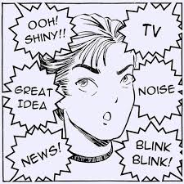

Derailing Creativity
Depravation
Distraction
Fatigue
Threat

Slide 56
What Is Your Threat Level?

Slide 57


Go To Your Highest Level Right Now
Notes:
Note that the emotional states with the lowest possible threat levels – and therefore the places from which you can be maximally creative – have names like “gratitude” and “love”.

Slide 58
Reclaiming Your Power
Liquidating Unhelpful Habits

Slide 59

Willpower Can Not Resist Your Habits!
But It Can Erase Any Habit!
Notes:
Because your normal consciousness is not really involved once a habit has been learned, it is nearly impossible for your willpower to directly oppose a habit. All that happens is you fail, and begin to associate trying to resist the habit with failing to resist the habit – and become even more deeply captured by the habitual behavior. Direct opposition as we’ve learned throughout this class is almost always a bad way to use our energy. Instead we need to remove the habit’s source of energy – and move it from the brain’s automatic habit superhighway back into the realm of something we make conscious choices about.

Slide 60

Every Habit Got Started The Same Way
Notes:
Even the most powerful habits and addictions began as associations, and a simple process can break them.

Slide 61




Meet Your Two New Best Friends
Procrastination
Distraction
Notes:
Procrastination & Distraction
Procrastination:
When you feel the urge to act arise: delay!
The classic: “Count to 10.”
Others:
“I will check again for his text messages after 6 slow breaths.”
“I will eat the donut after I walk around the block first.”
Create delays of at least two minutes if at all possible.
Distraction:
During that delay: Change your focus!
Socialize, eat or drink
Wash your hands
Take a walk
Play a game
Watch a video
Engage your senses
Instead of acting out the habitual behavior, give your Fast Thinking new associations! This is not a trick to deny yourself. After the delay, you can always perform the habit if you still want to. Just by waiting, it will be weaker.

Slide 62
Bibliography
Daniel Kahneman, Thinking, Fast and Slow.
Jonah Lehrer, How We Decide.
Richard Precht, Who Am I, and If So, How Many?
Steven Pinker, How the Mind Works.
Malcolm Gladwell, Blink.
John Medina, Brain Rules.
Rich Hanson, Buddha’s Brain.
Thomas Metzinger, The Ego Tunnel.
Email me at david@casti.com

